Slide 1
Finding Street Gang Members on Twitter
Presented at the Big Data Surveillance Analytics Mini Conference at Wright State University Dayton, OH, USA, July 22, 2016
Sanjaya Wijeratne PhD Student @ Kno.e.sis Center Department of Computer Science and Engineering Wright State University, Dayton, OH
sanjaya@knoesis.org
Ohio Center of Excellence in Knowledge-enabled Computing (Kno.e.sis)
Wright State University, Dayton, OH, USA

Slide 2
Collaborators
Faculty
Amit Sheth
amit@knoesis.org
Derek Doran
derek@knoesis.org
Jack L. Dustin
Jack.dustin@wright.edu
Grad Students
Sanjaya Wijeratne
sanjaya@knoesis.org
Lakshika Balasuriya
lakshika@knoesis.org

Slide 3
Tweets Source – http://www.wired.com/2013/09/gangs-of-social-media/all/ Image Source – http://www.7bucktees.com/shop/chi-raq-chiraq-version-2-t-shirt/ *Example tweets shown above are public data reported in the cited news paper article. They are not part of our research dataset.
Notes:
Tweets Source - http://www.wired.com/2013/09/gangs-of-social-media/all/
Image Source - http://www.7bucktees.com/shop/chi-raq-chiraq-version-2-t-shirt/
*Example tweets shown above are public data reported in the cited news paper article. They are not part of our research dataset

Slide 4
What does gang related research tell us?
“Gangs use social media mainly to post videos depicting their illegal behaviors, watch videos, threaten rival gangs and their members, display firearms and money from drug sales” [Patton 2015, Morselli 2013]
Studies have shown,
82% of gang members had used the Internet and 71% of them had used social media [Decker 2011]
45% of gang members have participated in online offensive activities and 8% of them have recruited new members online [Pyrooz 2013]
Image Source – http://www.sciencenutshell.com/wp-content/uploads/2014/12/o-GANG-VIOLENCE-facebook.jpg
Notes:
Image Source - http://www.sciencenutshell.com/wp-content/uploads/2014/12/o-GANG-VIOLENCE-facebook.jpg

Slide 5
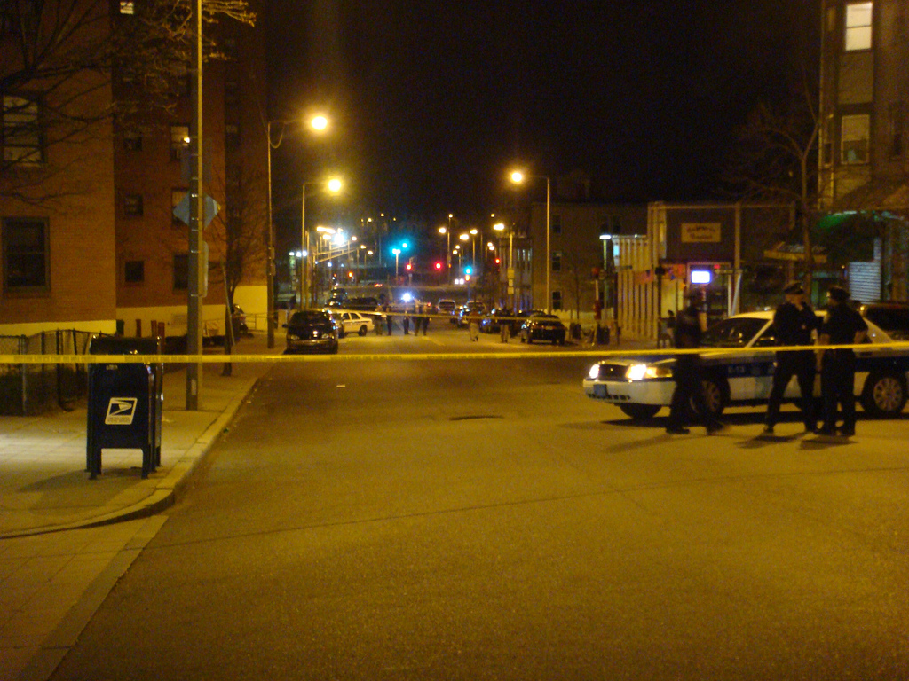
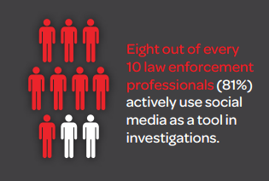
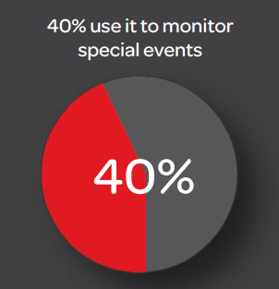
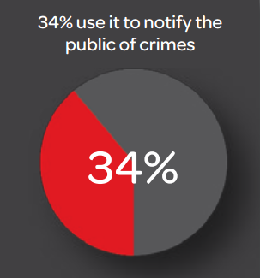
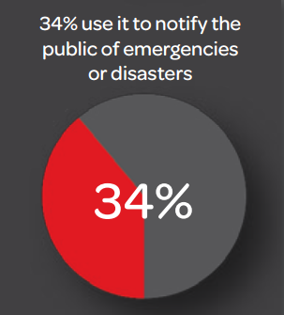
There are other spectators too…
Source – http://www.lexisnexis.com/risk/downloads/whitepaper/2014-social-media-use-in-law-enforcement.pdf
Image Source – http://www.officialpsds.com/images/stocks/crime-scene-stock1016.jpg
Notes:
Image Source - http://www.officialpsds.com/images/stocks/crime-scene-stock1016.jpg

Slide 6
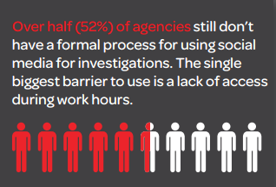
But there’s a problem…
Source – http://www.lexisnexis.com/risk/downloads/whitepaper/2014-social-media-use-in-law-enforcement.pdf
Image Source – http://www.officialpsds.com/images/stocks/crime-scene-stock1016.jpg
Notes:
Image Source - http://www.officialpsds.com/images/stocks/crime-scene-stock1016.jpg

Slide 7
Architecture of Our Platform
Wijeratne, Sanjaya et al. "Analyzing the Social Media Footprint of Street Gangs" in IEEE ISI 2015, doi: 10.1109/ISI.2015.7165945

Slide 8
Finding Street Gang Members on Twitter
Balasuriya, Lakshika et al. “Finding Street Gang Members on Twitter”, In IEEE/ACM ASONAM 2016 (To Appear)
Image Source – http://www.sciencenutshell.com/wp-content/uploads/2014/12/o-GANG-VIOLENCE-facebook.jpg
Notes:
Image Source - http://www.sciencenutshell.com/wp-content/uploads/2014/12/o-GANG-VIOLENCE-facebook.jpg

Slide 9
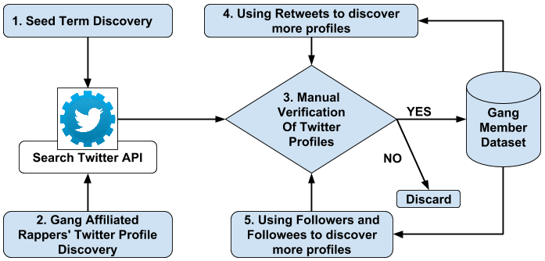
Data Collection
FreeDaGuys, RIPDaGuys, FreeMyNigga, FuckDaOpps
Gang Member Dataset Creation

Slide 10
Gang Member Dataset
We collected 400 gang members profiles
Non-gang member profiles were collected from Twitter Streaming and REST APIs
Filtered only US profiles – 2000 profiles collected
We added 865 manually verified non-gang member profiles collected from four seed words
To capture language used by family/friends of gang members
Description | Gang Member Class | Non-gang Member Class | Total
Number of Profiles | 400 | 2,865 | 3,265
Number of Tweets | 821,412 | 7,238,758 | 8,060,170

Slide 11
Data Analysis – Tweets
Words from Gang Member’s Tweets
Words from Non-gang Member’s Tweets

Slide 12
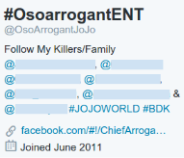
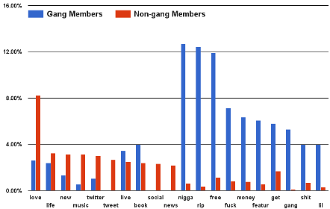
Data Analysis – Profile Descriptions
Percent of profiles that contain the word in profile description
Word usage in profile descriptions: Gang Vs. Non-gang members
*Example Twitter profiles shown above are public data reported in news articles. They are not part of our research dataset.
Notes:
*Example Twitter profiles shown above are public data reported in news articles. They are not part of our research dataset.

Slide 13
Data Analysis – Emoji
Percent of profiles that contains the emoji in Tweets
Emoji usage distribution: Gang Vs. Non-gang members

Slide 14
Data Analysis – Emoji Cont.
Emoji Chain | Gang Member Usage | Non-gang Member Usage
 | 32.25% | 1.14%
 | 53% | 1.71%
Emoji usage: Gang Vs. Non-gang members

Slide 15
Data Analysis – YouTube Links
51.25% of gang members post at least one YouTube video
76.58% of them are related to gangster hip-hop
A gang member shares 8 YouTube links on average
Top 5 words from gang members – shit, like, nigga, fuck, lil
Top 5 words from non-gang members – like, love, peopl, song, get

Slide 16
Data Analysis – Profile Images
Percent of profiles that contains the image tag
Image tags distribution: Gang Vs. Non-gang members

Slide 17
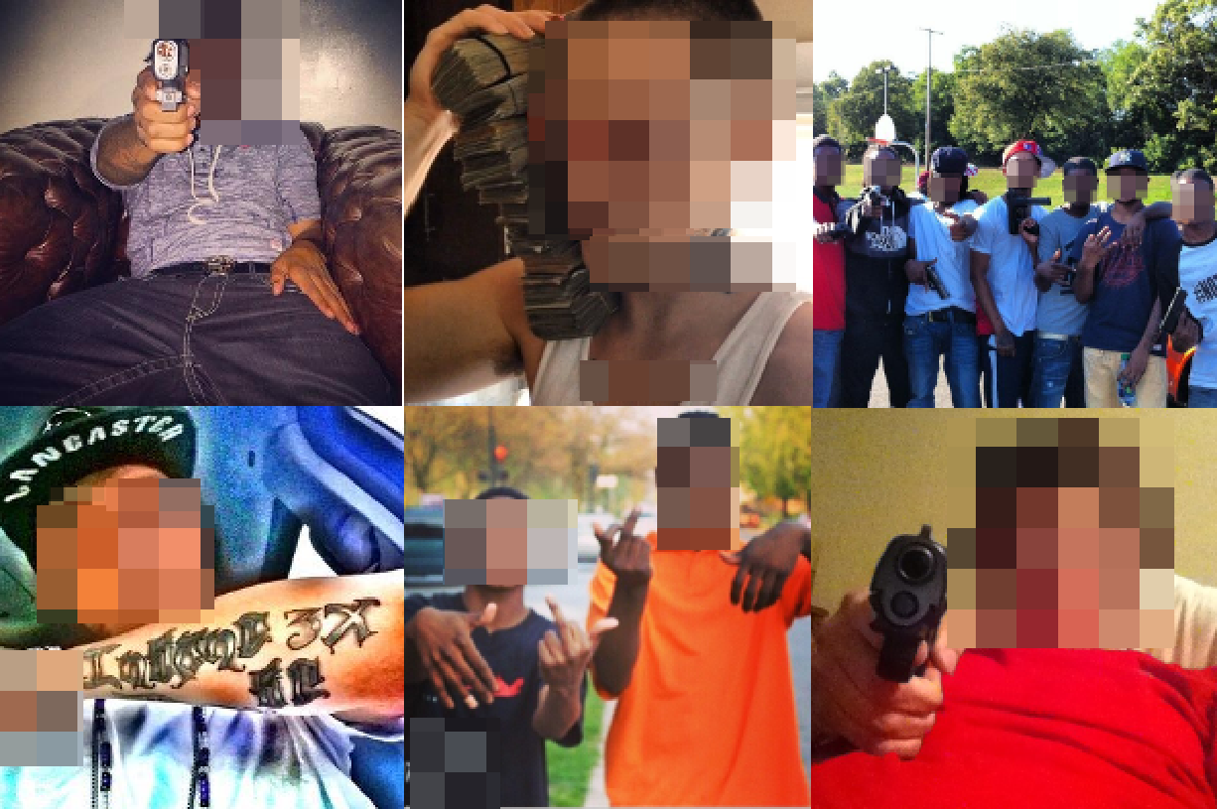
Data Analysis – Profile Images Cont.
Gang member tags – trigger, bullet, worship
Non-gang member tags – beach, seashore, pet
Gang Members’ Twitter Profile and Cover Images

Slide 18
Classification Approach
Used five feature types
Tweets, Profile Descriptions, Emojis, Profile and cover images, YouTube videos
Converted all non textual features to text
Emoji for Python API for emoji¹
Clarifai API for profile and cover images²
Removed stop word and stemmed the remaining
Represented Twitter profiles using unigrams
Trained four types of Classifiers (NB, LR, RF, SVM)
¹https://pypi.python.org/pypi/emoji | ²http://www.clarifai.com/

Slide 19
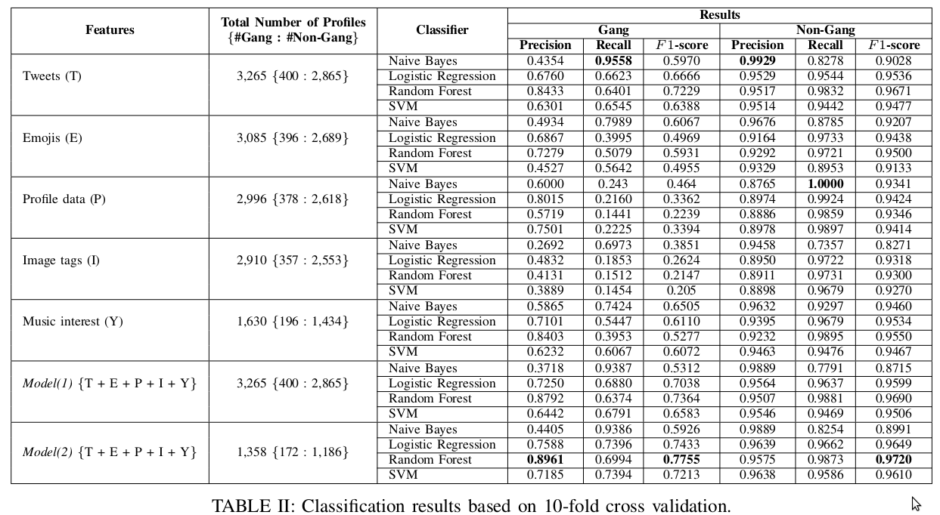
Classification Results

Slide 20
Our Classifier in Action
Twitter profiles collected from neighborhoods that are known for gang-related activities
Los Angeles, CA – 15,662 Profiles
Southside of Chicago – 8,500 Profiles
Classified using Model(2) RF Classifier and qualitatively studies the “Gang” class
Displayed weapons in their profile images
Gang-related names in their profile descriptions
Frequent use of curse words
Referred to known gang members as “my hommies”

Slide 21
Our Classifier in Action Cont.
Most frequent words in Tweets
shit, nigga, got, bitch, go, fuck
Most frequent words in user profiles
free, artist, shit, fuck, freedagang, ripthefallen
Most frequent emoji –

Slide 22
Enhance Twitter Gang Member Profile Identification using Word Embeddings
Wijeratne, Sanjaya et al. “Word Embeddings to Enhance Twitter Gang Member Profile Identification”, SML Workshop @ IJCAI, 2016
Image Source – http://www.sciencenutshell.com/wp-content/uploads/2014/12/o-GANG-VIOLENCE-facebook.jpg
Notes:
Image Source - http://www.sciencenutshell.com/wp-content/uploads/2014/12/o-GANG-VIOLENCE-facebook.jpg

Slide 23
Gang Member Dataset
Description | Gang Member Class | Non-gang Member Class | Total
Number of Profiles | 400 | 2,865 | 3,265
Number of Tweets | 821,412 | 7,238,758 | 8,060,170
Number of Words from each Feature | Gang Member Class | Non-gang Member Class | Total
Tweets | 3,825,092 | 45,213,027 | 49,038,119
Profile Descriptions | 3,348 | 21,182 | 24,530
Emoji | 732,712 | 3,685,669 | 4,418,381
YouTube Videos | 554,857 | 10,459,235 | 11,041,092
Profile Images | 10,162 | 73,252 | 83,414
Total | 5,126,176 | 59,452,365 | 64,578,536

Slide 24
Classification Approach
Converted all non textual features to text
Emoji for Python API for emoji¹
Clarifai API for profile and cover images²
Removed stop word and stemmed the remaining
Trained a Skip-gram model using textual features
Negative sample rate = 10
Context window size = 5
Ignore words with min count = 5
Number of dimensions = 300
¹https://pypi.python.org/pypi/emoji | ²http://www.clarifai.com/

Slide 25
Classification Approach Cont.
Classifier training with word embeddings

Slide 26
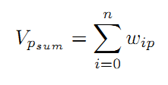
Representing Training Examples
For each Twitter profile p, with n unique words, and the vector of the i^{th} word in p denoted by w_{ip}, we compute the feature vectors for V_{p} in the following ways.
Sum of word embeddings – Sum of word vectors for all words in Twitter profile p

Slide 27
Representing Training Examples Cont.
Mean of word embeddings – Mean of word vectors for all words in Twitter profile p
Sum of word embeddings weighted by term frequency where term frequency of i^{th} word in p is denoted by c_{ip}

Slide 28
Representing Training Examples Cont.
Sum of word embeddings weighted by tf-idf where tf-idf of i^{th} word in p is denoted by t_{ip}
Average sum of word embeddings weighted by term frequency where term frequency of i^{th} word in p is denoted by c_{ip}.

Slide 29
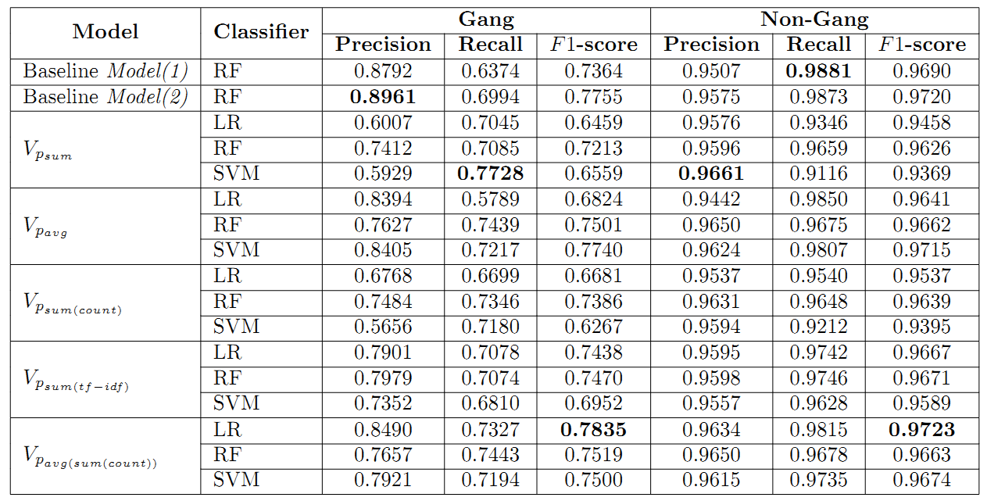
Classification Results
Classification results based on 10-fold cross validation

Slide 30
Results Interpretation
Averaging the vector sum weighted by term frequency performs the best
Out of the five vector based operations on word embeddings;
Four of them gave classifiers that beat baseline model(1)
Two of them performed as nearly equal or beat baseline model(2)

Slide 31
Results Interpretation Cont.
Word vector (top 10) for BDK showed
Five were rival gangs of Black Disciples
Two were syntactic variations of BDK
Three were syntactic variations of GDK
Word vector (top 10) for GDK showed
Six were Gangster Disciple gangs where others have expressed their hatred towards them
Word vector (top 10) for CPDK showed
Other keywords showing hatred towards cops such as fuck12, fuckthelaw, fuk12 and gang names

Slide 32
Recap
Gang members are actively using Twitter
Discussed our approach to identify gang members on Twitter (ASONAM 2016)
What do they post on Twitter and what types of features could help to identify their profiles
Discussed how word embeddings can be used to improve gang member Twitter profile identification (SML@IJCAI 2016)
Looked at examples of interesting information that word embeddings can tell us about gangs

Slide 33
Challenges and Future work
Build image recognition systems that can accurately identify images commonly posted by gang members
Guns, Drugs, Money, Gang Signs
Integrate slang dictionaries and use them to pre-train word embeddings
Hipwiki.com
Utilize social networks of gang members to identify new gang members
Image Source – http://i.ytimg.com/vi/dqyYvIqjuFI/maxresdefault.jpg
Notes:
Image Source - http://i.ytimg.com/vi/dqyYvIqjuFI/maxresdefault.jpg

Slide 34
Connect with me
sanjaya@knoesis.org
@sanjrockz
http://bit.do/sanjaya
Image Source – http://www.pcb.its.dot.gov/standardstraining/mod08/ppt/m08ppt23.jpg
Notes:
Image Source - http://www.pcb.its.dot.gov/standardstraining/mod08/ppt/m08ppt23.jpg

Slide 36
References
[1] D. U. Patton, “Gang violence, crime, and substance use on twitter: A snapshot of gang communications in Detroit,” Society for Social Work and Research 19th Annual Conference: The Social and Behavioral Importance of Increased Longevity, Jan 2015
[2] C. Morselli and D. Decary-Hetu, “Crime facilitation purposes of social networking sites: A review and analysis of the cyber banging phenomenon,” Small Wars & Insurgencies, vol. 24, no. 1, pp. 152–170, 2013
[3] S. Decker and D. Pyrooz, “Leaving the gang: Logging off and moving on. Council on foreign relations,” 2011

Slide 37
References Cont.
[4] D. C. Pyrooz, S. H. Decker, and R. K. Moule Jr, “Criminal and routine activities in online settings: Gangs, offenders, and the internet,” Justice Quarterly, no. ahead-of-print, pp. 1–29, 2013
[5] S. Wijeratne, D. Doran, A. Sheth, and J. L. Dustin, “Analyzing the social media footprint of street gangs”, In Proc. of IEEE ISI, 2015, pages 91–96, May 2015.
[6] L. Balasuriya, S. Wijeratne, D. Doran, and A. Sheth, “Finding street gang members on twitter”, In The 2016 IEEE/ACM International Conference on Advances in Social Networks Analysis and Mining (ASONAM 2016). San Francisco, CA, USA; 2016 (To Appear).

Slide 38
References Cont.
[7] S. Wijeratne, L. Balasuriya, D. Doran, A. Sheth, “Word Embeddings to Enhance Twitter Gang Member Profile Identification”, In IJCAI Workshop on Semantic Machine Learning (SML 2016). New York City, NY: CEUR-WS; 2016.

